Slide 1
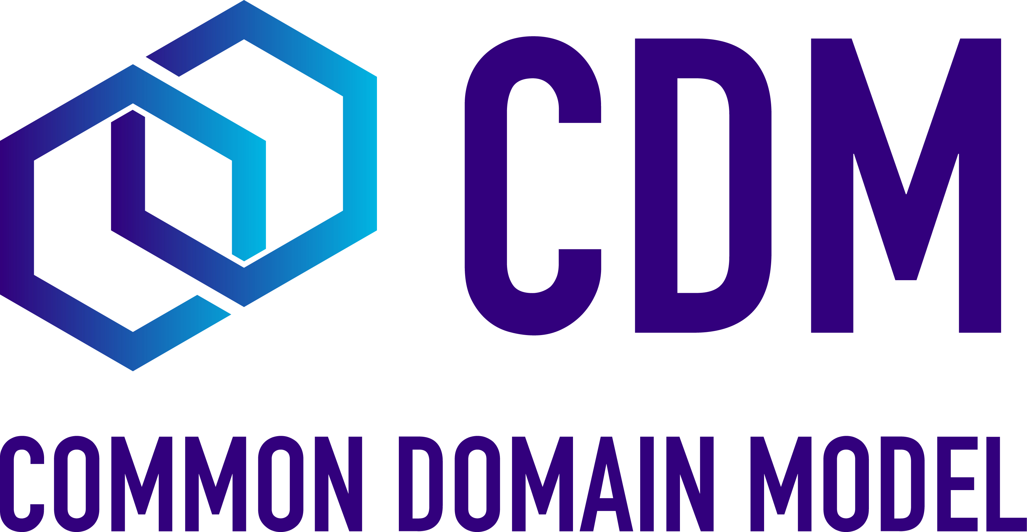
CDM Target Operating Model 2025:
High Level Roles and Activities
Governance
Modeling/Design
Technical
Adoption
Administrative / Other
Define & Publish the Roadmap
(via Steering WG)
Data Modeling
(via Domain WGs)
Build process automation
CDM Events (Showcase, webinars, conferences)
Project microsite
Define & Approve Releases
(via Contribution Review WG)
Design Documentation & microsite maintenance
Deployment/release processes, binaries publishing
Adoption use cases
Licenses (Apache, CSL)
Approve Pull Requests
(Maintainers)
Detailed domain WG
roadmap development
Tech design (architecture, infrastructure, via TAWG)
Documented Examples (resource center, case studies, Expos, etc.)
Meeting administration
Release Management & Coordination
Technical Documentation & microsite maintenance
Hackathons
& workshops & Training etc.
Recruit. & approval of other (addnl) Maintainers
Technical support
Shared resource of CDM use cases for community
Design Principles
Marketing: hosting & visiting events, written materials etc.
Investment Oversight
Licence Management (overseen by Steering WG)
Actions by Associations/ Maintainers
Actions by FINOS
Actions by centralised paid contributors
Actions by project community contributors
Actions by project community (not contributing but using)

